Slide 1

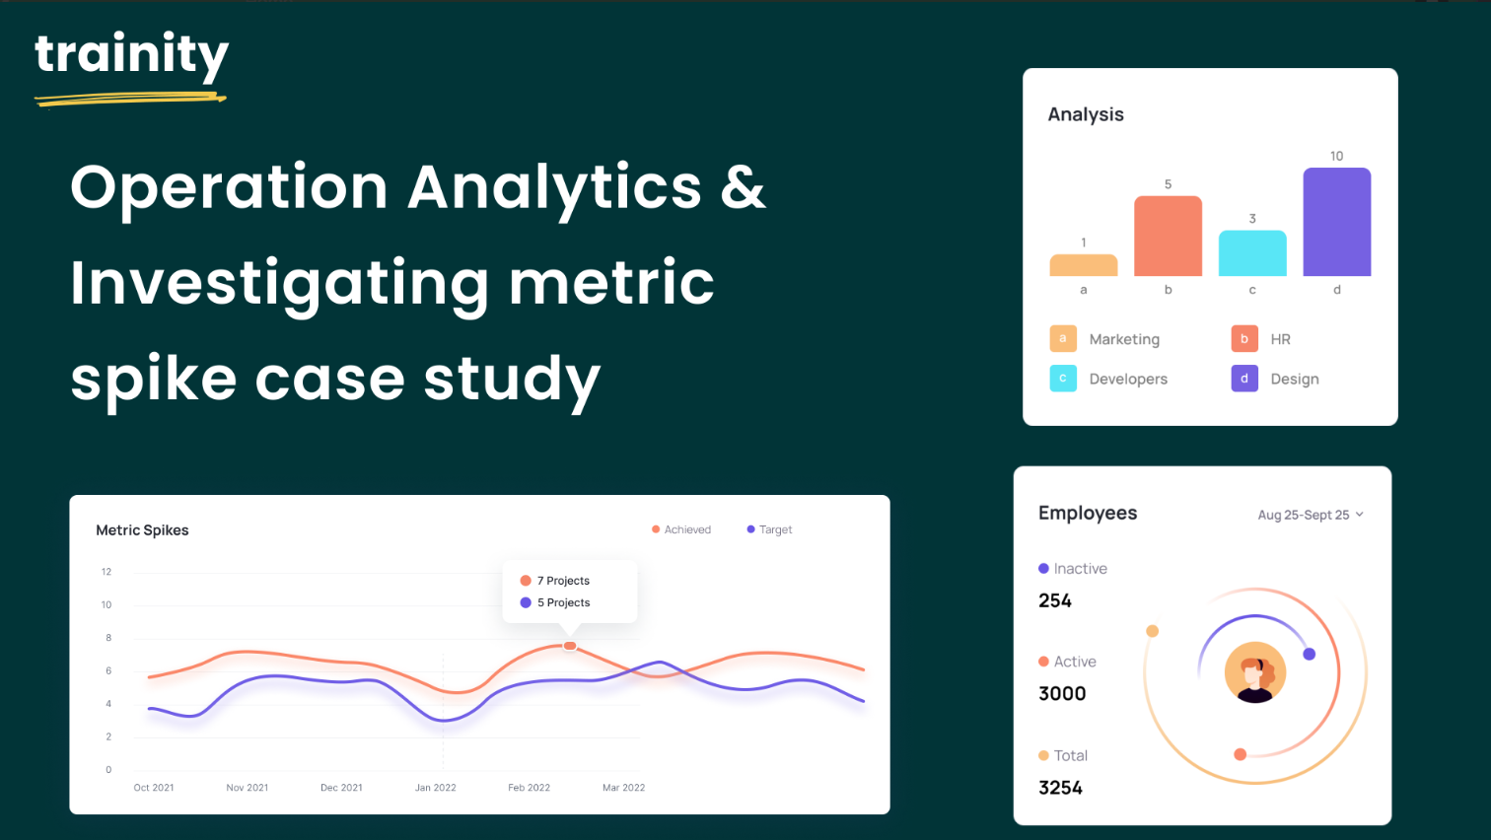

Slide 2
Operation Analytics and Investigating Metric Spike
Description: Analyzing the company's end-to-end operations Operation Analytics is an essential procedure. With the help of operational analytics, the company identifies the areas that need improvement. As a data analyst, we will collaborate directly with various teams, including operations, support, and marketing, to assist them in gaining insightful information from the data they gather.
The investigation metric spike is a critical aspect of operational analysis that entails understanding and explaining sudden changes in key metrics, such as a decline in daily user engagement or a decline in revenue. Knowing how to look into these metric spikes is vital since, as a data analyst, you will have to respond to these questions frequently. As an analyst, knowing how to look into these metric increases is critical because you'll have to respond to these inquiries every day.

Slide 3
Approach :
Create the Database and Tables: First, create a database for the project, and then create the necessary tables using the provided table structures and links. Then import the CSV file into MySQL Workbench.
Perform Analysis: I used MySQL to perform the analysis and answer the questions mentioned in the case studies.

Slide 4
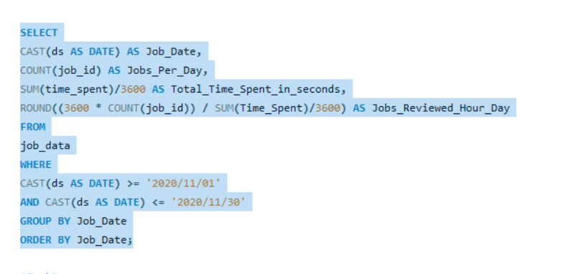
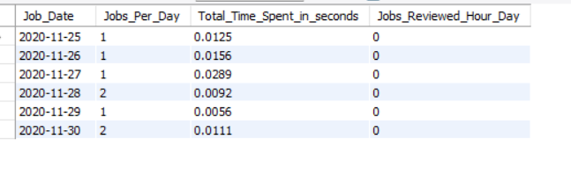
Job Data Analysis:
Task 1 : Jobs Reviewed Over Time
Objective: Calculate the number of jobs reviewed per hour for each day in November 2020.
Task: Calculate the number of jobs reviewed per hour for each day in November 2020.
SQL Query :
Result:

Slide 5
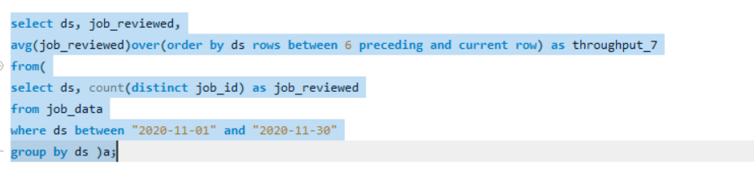
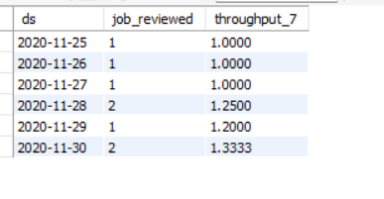
Task 2 : Throughput Analysis
Objective: Calculate the 7-day rolling average of throughput (number of events per second).
Task: Calculate the 7-day rolling average of throughput. Also, explain why you prefer using the daily metric or the 7-day rolling average for throughput.
SQL Query :
Result:

Slide 6
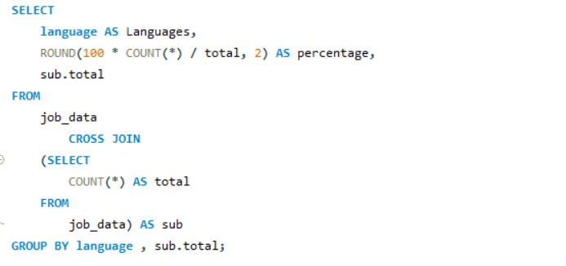
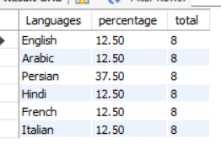
Task 3: Language Share Analysis
Objective: Calculate the percentage share of each language in the last 30 days.
Task: Write an SQL query to calculate the percentage share of each language over the last 30 days.
SQL Query :
Result:

Slide 7
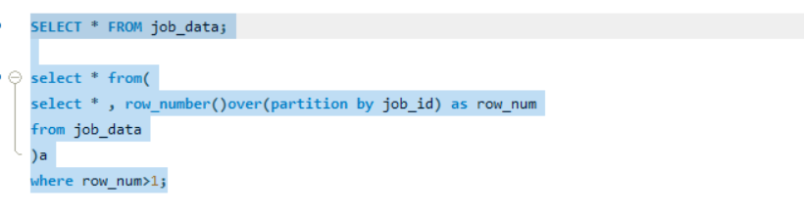
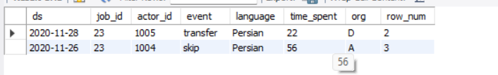
Task 4: Duplicate Rows Detection
Objective: Identify duplicate rows in the data.
Task: Write an SQL query to display duplicate rows from the job_data table.
SQL Query :
Result:

Slide 8
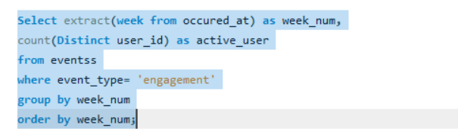
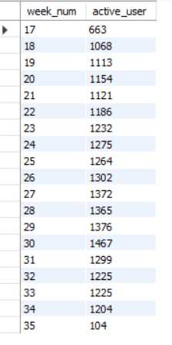
Investigating Metric Spike:
Task 1: Weekly User Engagement
Objective: Measure the activeness of users on a weekly basis.
Task: Write an SQL query to calculate the weekly user engagement.
SQL Query :
Result:

Slide 9
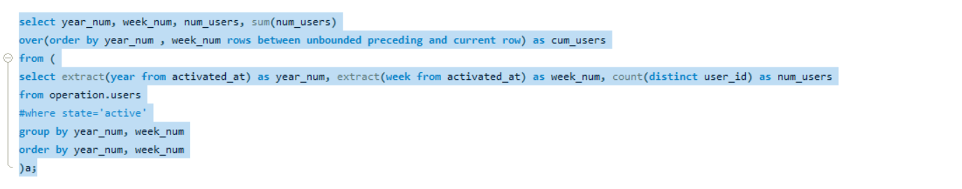
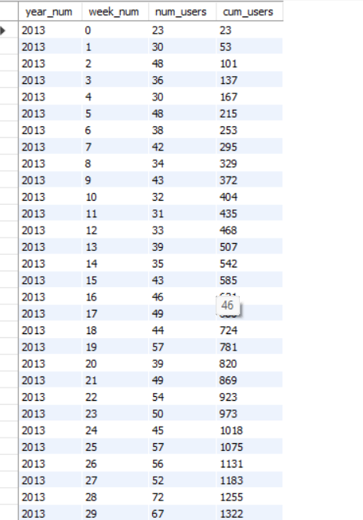
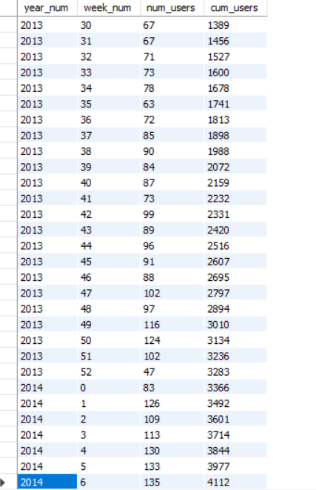
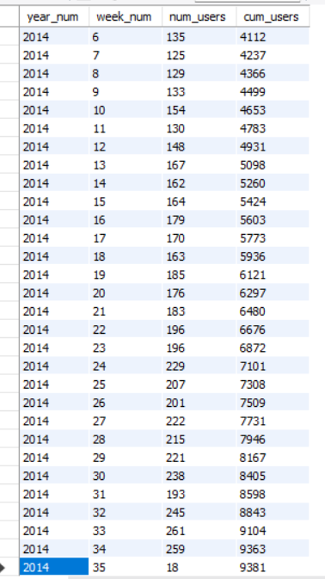
Task 2: User Growth Analysis
Objective: Analyze the growth of users over time for a product.
Task: Write an SQL query to calculate the user growth for the product.
SQL Query :
Result:

Slide 10
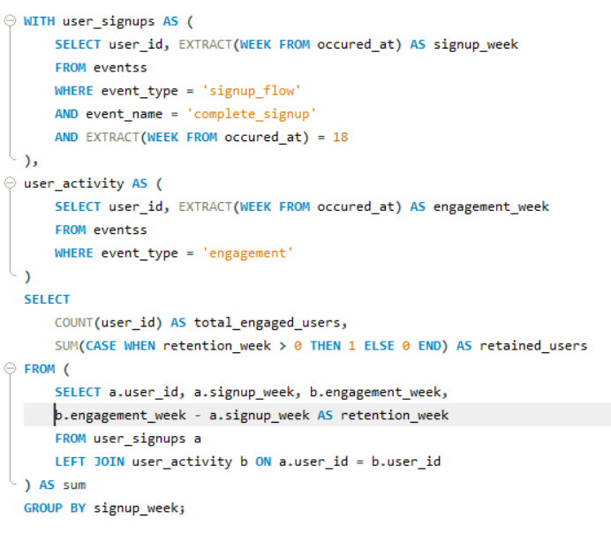

Task 3: Weekly Retention Analysis
Objective: Analyze the retention of users on a weekly basis after signing up for a product.
Task: Write an SQL query to calculate the weekly retention of users based on their sign-up cohort.
SQL Query :
Result:

Slide 11
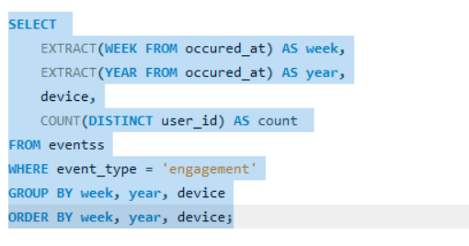
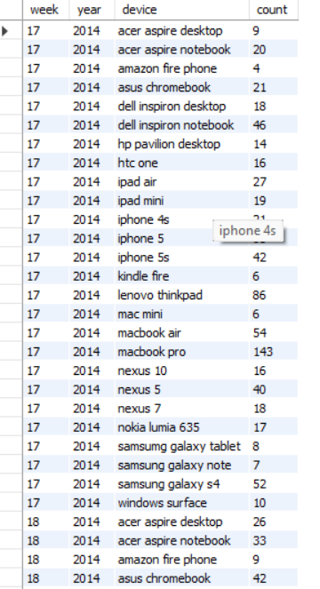
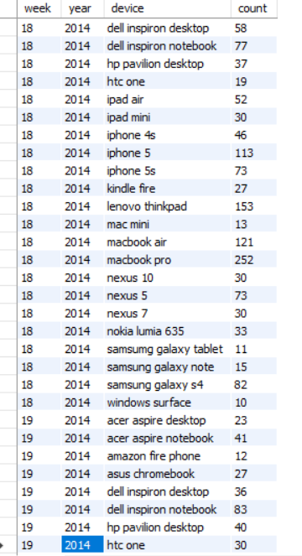
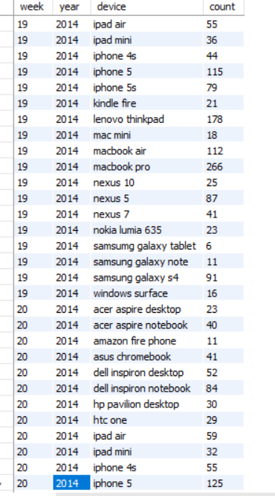
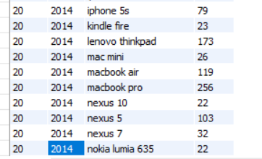
Task 4: Weekly Engagement Per Device
Objective: Measure the activeness of users on a weekly basis per device.
Task: Write an SQL query to calculate the weekly engagement per device.
SQL Query :
Result:

Slide 12
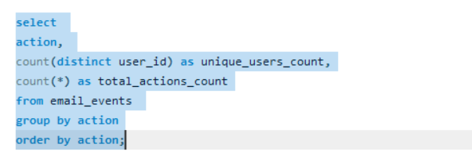
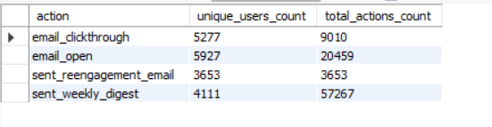
Task 5: Email Engagement Analysis
Objective: Analyze how users are engaging with the email service.
Task: Write an SQL query to calculate the email engagement metrics.
SQL Query :
Result:

Slide 13
Thank You

